Slide 1

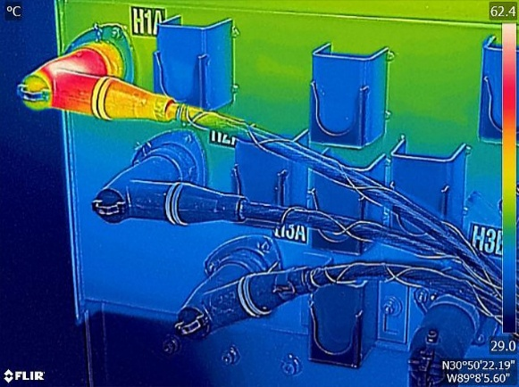
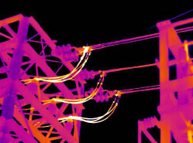
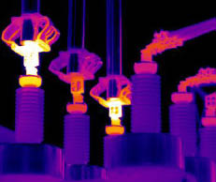

Early Detection of TM Utilities Failure via Thermal Imaging
TEAM NAME : THERMAL
FAUZY CHE YAYAH , Mohd FAIROZ AKASHAH, MAY YEONG HUI TZE
ITNT

Slide 2
Problem Statement
Electric power utilities are faced with an aging infrastructure, increasing risk of blackouts and brownouts.
A brownout is a drop in voltage in an electrical power supply, so named because it typically causes lights to dim. Utilities also face costly unplanned maintenance and rising costs
Utilities are looking for ways to address these issues in order to improve the reliability of electric power delivery while at the same time reducing costs.
By using thermal imaging cameras and automation software, future equipment failures can be detected anytime, day or night, at a remote monitoring location.
The net effect is increased reliability and reduced cost.

Slide 3
Proposed Solution
Development of a mobile application to capture thermal images.
Taking images from various TM Utilities ( MSAN, DSLAM, CABINETS, etc. )
Obtaining GPS location of the selected equipment.
Thermal image processing extraction using standard FLIR images via Exif.
Quantitative way detection of the outlier of thermal images.
Clustering the temperature matrix and getting the temperature reading (min, max, average).
Thermal image gallery display via OpenShift (PHP Application Hosting)

Slide 4
Required API & Software
OpenShift with R , Rstudio Shiny
https://stefanopicozzi.blog/2016/11/17/r-using-rstudio-server-with-openshift/
https://github.com/openshift-quickstart/r-quickstart
https://github.com/primaryobjects/shiny-ekergy
OpenShift PHP Application Hosting & MySQL Server
ThermImage R package - https://cran.r-project.org/web/packages/Thermimage/index.html
ExifTools - http://www.sno.phy.queensu.ca/~phil/exiftool/install.html
Netbeans 8.1 for Mobile Development - https://netbeans.org/downloads/8.1/?pagelang=
Gradle Plugins - http://plugins.netbeans.org/plugin/44510/gradle-support
Android SDK 25.2.5 - https://developer.android.com/studio/releases/sdk-tools.html
Flir SDK - https://flir.box.com/shared/static/c2kr3aru63jymmnvgu0lxdn9l708j1k4.zip

Slide 5
Forward looking infrared (FLIR)

Slide 6
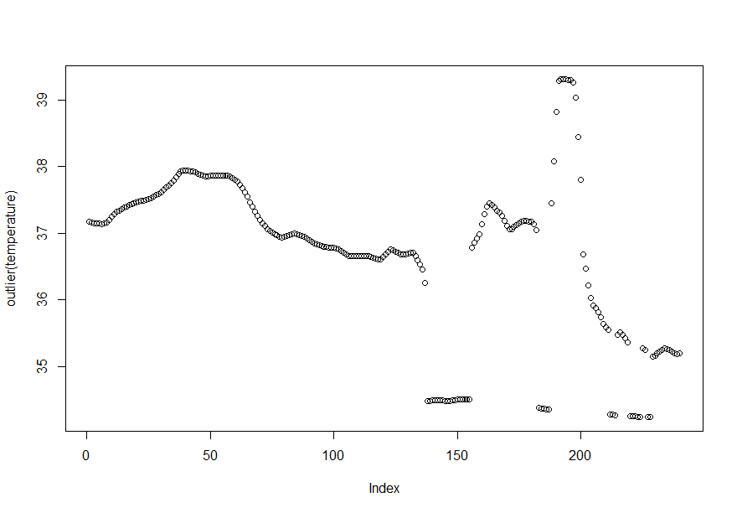

Slide 7
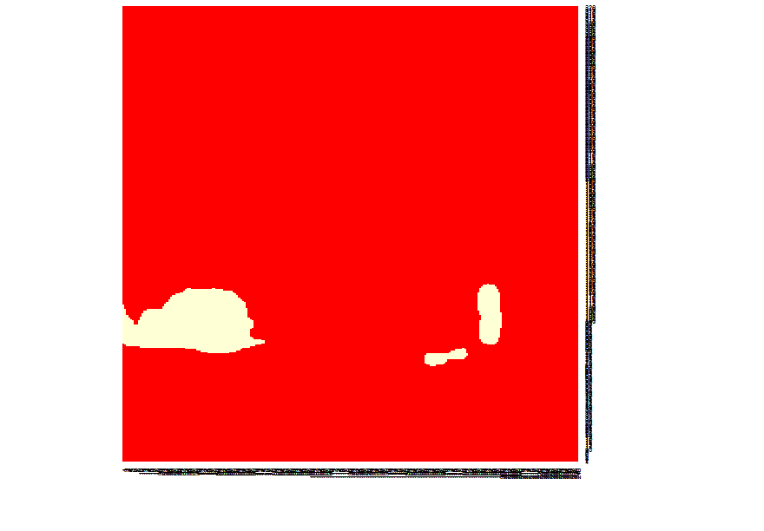

Slide 8
System Architecture

Slide 9
Type of thermal images
White Hot
Black Hot
Rainbow
Contrast
Arctic
Larva
Coldest
Hottest

Slide 10
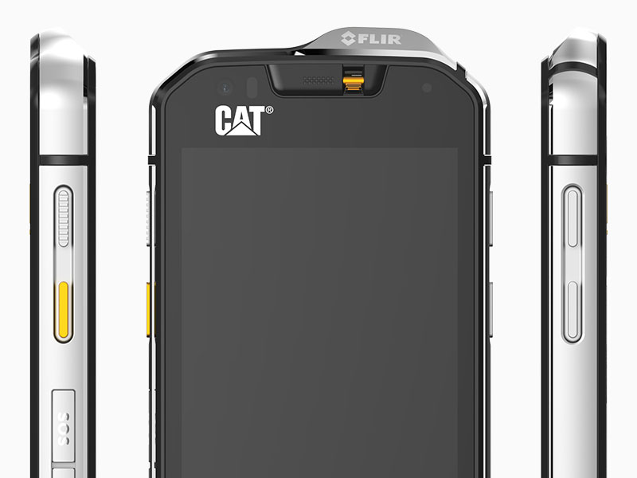
Hardware
CAT S60 Model
Android 6.0 Marshmallow
FLIR Thermal Camera
IP68 Certified
Category 4 vibration

Slide 11

Thank You

Slide 12
Reference
http://www.flir.com/automation/display/?id=41743

